Slide 1
Linksfoundation.com
GeoData Lake
Federico Oldani
Notes:
Sono stati creati diversi «Schemi diapositiva» che permettono di avere già delle slide di esempio già da poter utilizzare.
I testi sono stati creati nel font Arial affinché non ci siano problemi di incompatibilità tra font.
I colori utilizzati sono quelli della Fondazione LINKS (Progettazione>Colori> Fondazione LINKS.
E’ possibile sostituire le immagini di esempio con la seguente procedura:
1)Selezionare l’immagine della slide e cancellarla
2) Cliccare sul bottone sotto la frase « fare clic sull’icona per inserire un’immagine»
3) Selezionare ed inserire l’immagine scelta
4) Selezionare l’immagine e sotto Formato> Porta indietro mettere Porta in secondo piano
Per visualizzare le guide che delineano i margini della slide Visualizza>Guide
La data è stata programmata per aggiornarsi in automatico. Qualora si volesse cambiare il luogo e la data stessa: Visualizza > Schema diapositiva > Mastro 2 > sostituite luogo/ data

Slide 2
Objective
This is a short guide for using the Geodata repository, which is the repository for the all the data collected during the project.
GeoData Lake can deal with an enormous quantity of heterogeneous data:
Geo-environment data
Satellite imagery
Weather forecasts
Social big data
Sensor data
Crowdsource data
…
GEODATA LAKE

Slide 3





Architecture
The GeoData Lake is mainly composed of two components:
Storage Layer: where all the original files are stored
Catalog Layer: Metadata container. Each file (or group of files) is described by a metadata. The metadata help users to search, filter and retrieve the data
The data collected in the Data Lake respects the FAIR principles (Findability, Accessibility, Interoperability and Reusability) and the metadata is complaint with INSPIRE Metadata.
Users
Authentication
Catalog Layer
Messaging System
(Metadata)
Data Lake
Storage Layer
(raw data)

Slide 4
Usage
The GeoData Lake can be used via API or web-based interface
URL: datalake.gaia-project.cloud
Authentication
Each partner will receive the credentials for accessing the platform

Slide 5
GUIDE Web based interface

Slide 6
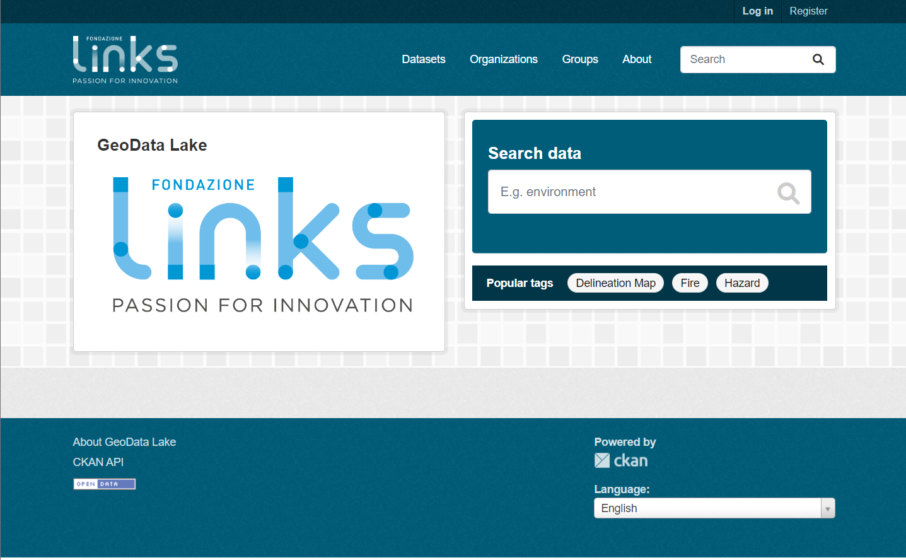
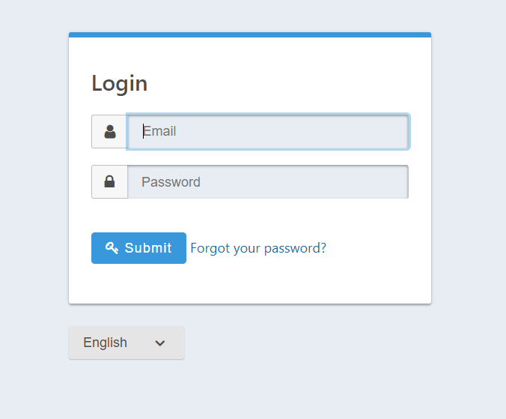
User authentication

Slide 7
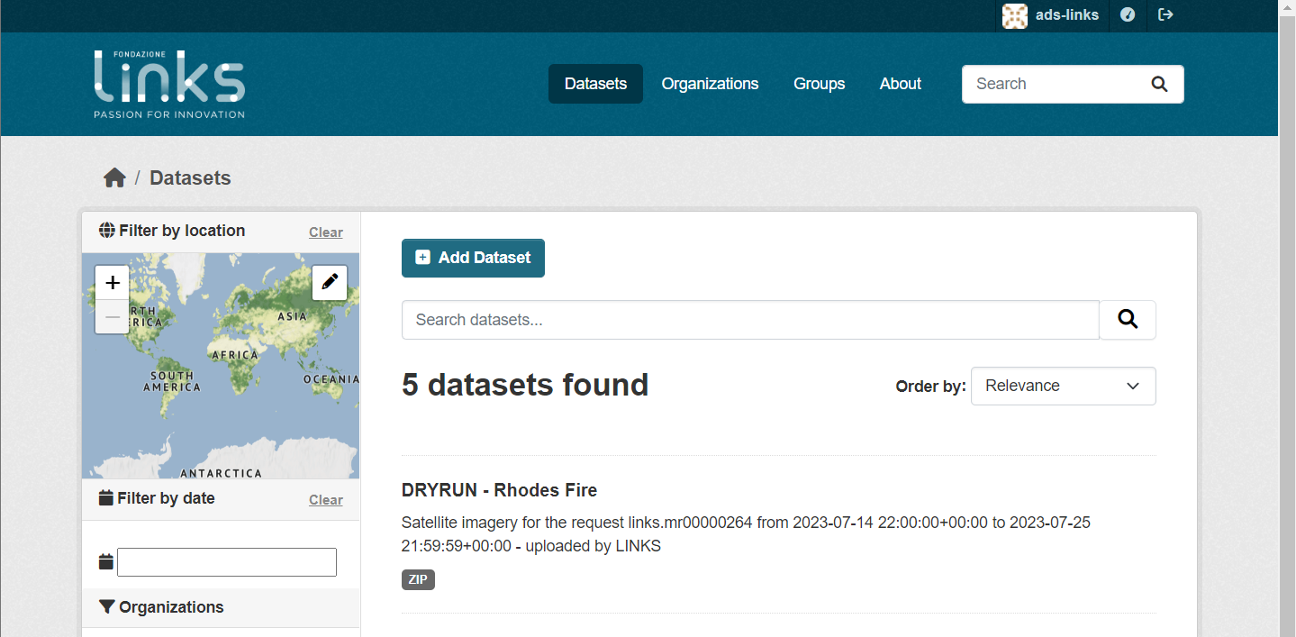
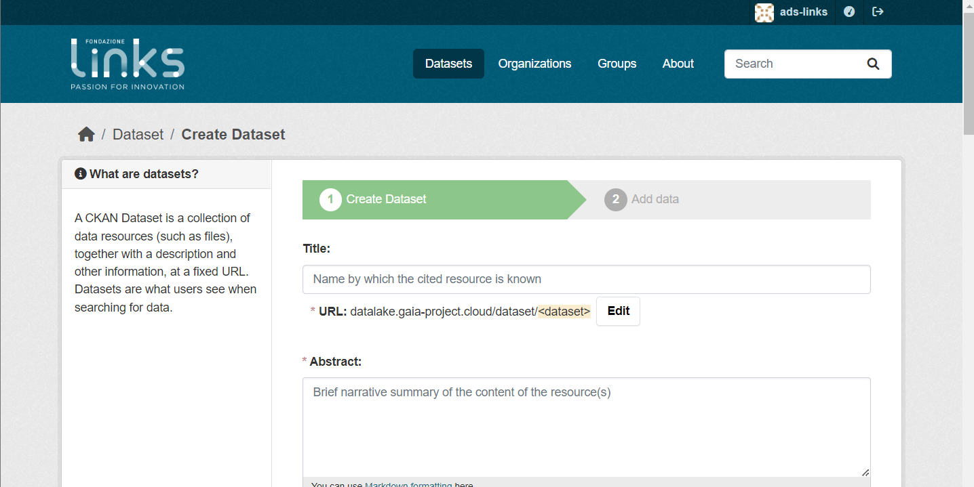
Upload data (1/2)
As mention in the introduction, for each data (or group of data if it refers to the same event) the user must create a metadata to describe what she/he is going to upload.
To create a metadata go to Dataset > Add Dataset
Fill the form with the information of the data you want to upload. The metadata must be compliant with INSPIRE metadata (for the interoperability with the european union spatial data infrastructure). The form is quite long but the more precise information is contained, the easier will be the search of the data among all the data collected. The description of each field can be find in the excel file attached (Sheet: DataLake_Fields).

Slide 8
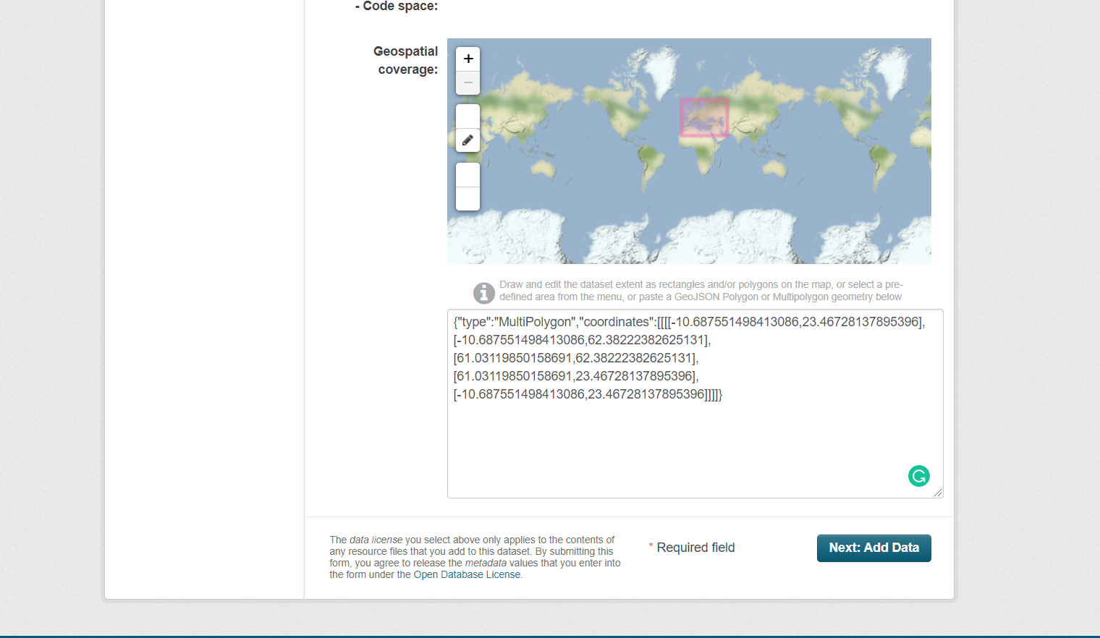
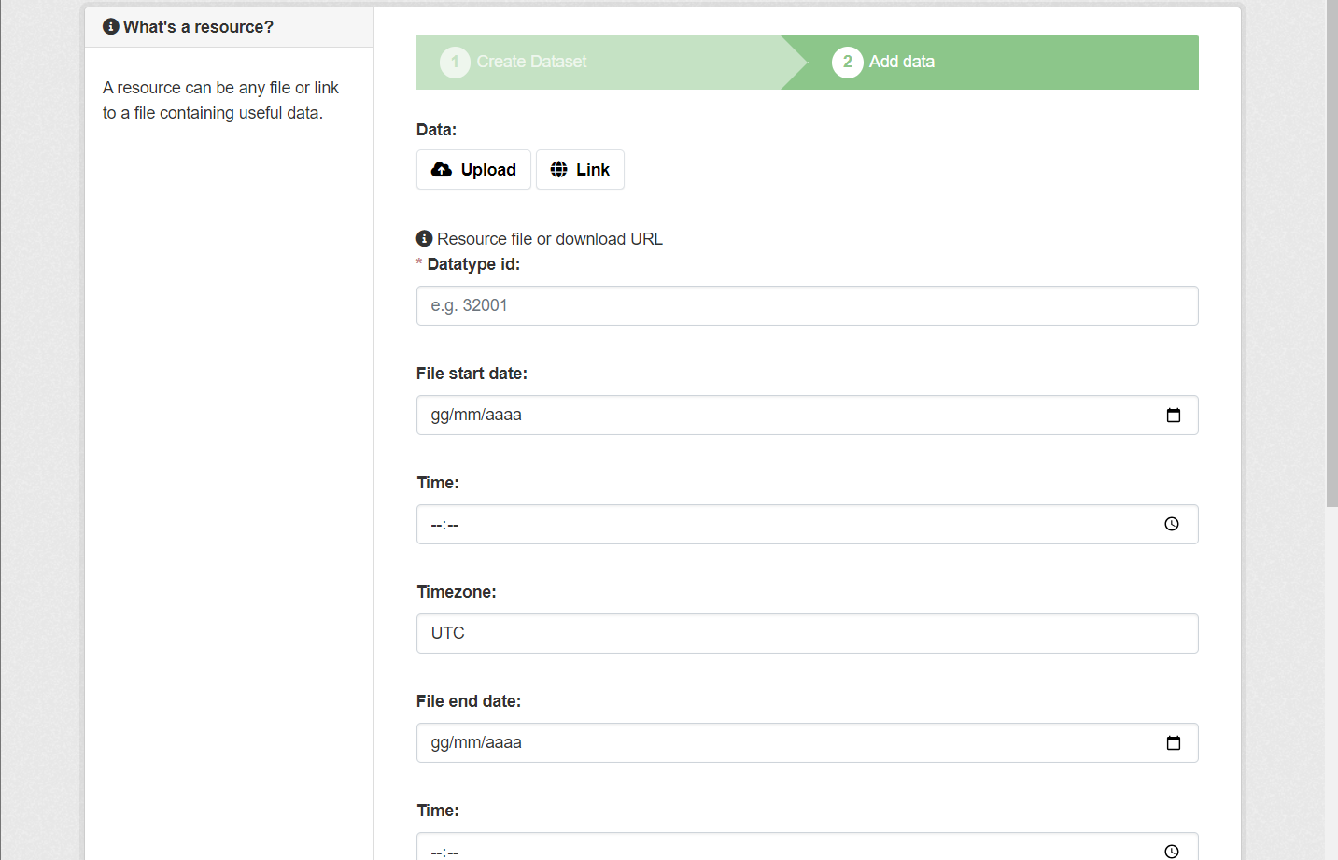
Upload data (2/2)
Once the form is filled, click on Next: add Data. If there are errors in the form, the system will ask you to modify your entries before proceed.
The file can be uploaded from local storage (Upload) or can be linked from an other web source (Link). The preferred choice is Upload because the data would remain always available on the GeoData Lake. Few more information about the data can be specified in the form below. Please fill Format field with the extension of the file is going to be uploaded. In this way the system will show a preview of the file (if extension is supported) when a user search for it.
To add a new data click on Save & add another, otherwise Finish.

Slide 9
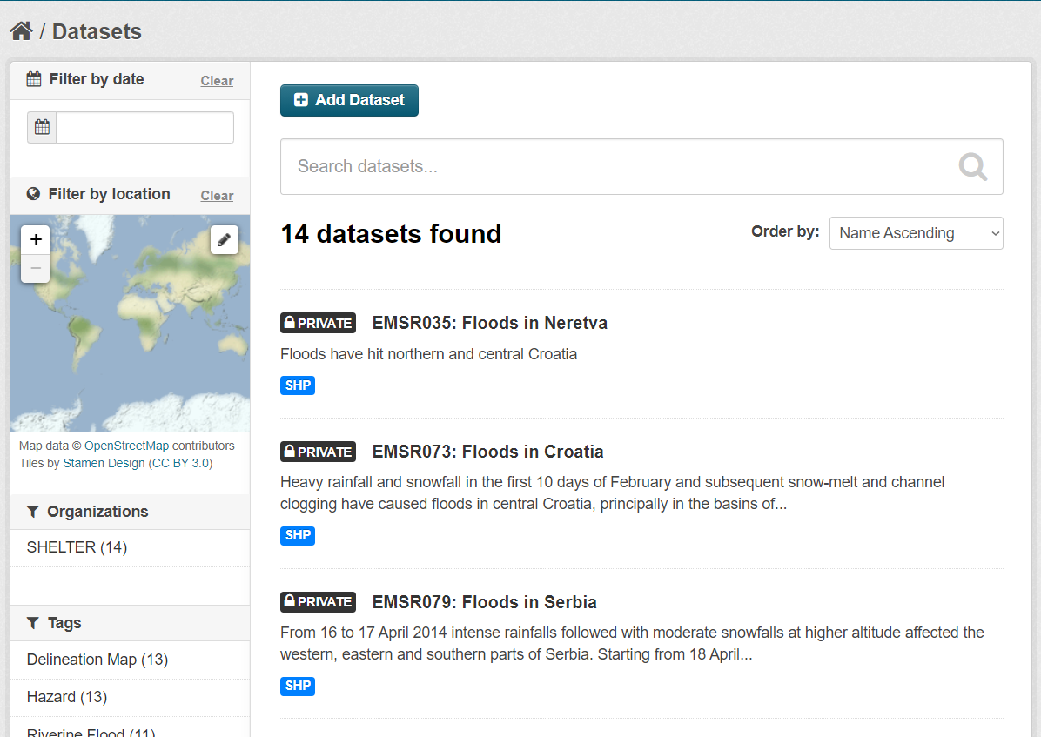
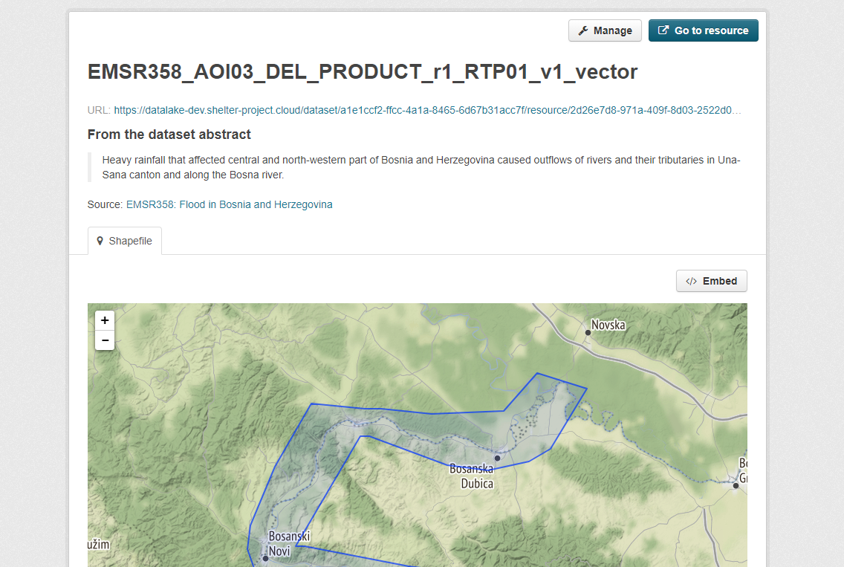
Data search and view
To search the data, the users can use different filters. Clicking on a dataset, the metadata is shown with the list of all the data associated. Click on a data to see details, its preview (if preview of that extension is shown) and the link for the download
Filter by:
Name
Tag (ontology)
Geographic area
Date
File extension

Slide 10
GUIDE API Advice: look the code examples [read the README file] and the Postman collection

Slide 11
User authentication
To access via API, we will provide the following information. DO NOT SHARE with anyone not involved
Callback URL | https://datalake.gaia-project.cloud/oauth2/callback
Auth URL | https://auth.gaia-project.cloud/oauth2/authorize
Access Token URL | https://auth.gaia-project.cloud/oauth2/token
Client ID | You will receive this information
Client Secret | You will receive this information
API key | You will receive this information
Username and password | You will receive this information

Slide 12
Upload data
Create metadata first
As mentioned in the introduction, for each data (or group of data if it refers to the same event) the user must create a metadata to describe what she/he is going to upload.
The API to create a metadata is [https_address]/api/action/package_create (for example https://datalake.gaia-project.cloud/api/action/package_create)
Call the API attaching a JSON file containing a dictionary with the matadata fields. The description of each field can be find in file INSPIRE_links.xlsx. The API returns the metadata ID, take note of it
Use the metadata ID to upload data and associate it to the metadata. The API is [https_address]/api/action/resource_create. Attach the following information to the request
Key name | Description
package_id | The id returned by the ‘package_create’ POST request (points 1-2)
format | File extension
datatype_resource | Datatype of the resource (see DataMappingForm)
file_date_start | Start datetime of validity (ISO 8601 format)
file_date_end | Stop datetime of validity (ISO 8601 format)
upload | [FILE TO UPLOAD]

Slide 13
Data search
To search the data, the users can use different filters. The API to search data is [https_address]/api/action/package_search (for example https://datalake.gaia-project.cloud/api/action/package_search).
The API allows to apply filters to search a particular dataset. Attach a JSON file with a dictionary to the request:
‘extras’: use this field to use the filters of date and geographic bounding box
‘fq_list’: list of other filters to apply
‘include_private’: set always as true
{
"extras": {
"ext_bbox": "14.2703644857,43.838398153,18.8065034971,45.899587909",
"ext_startdate":"2000-06-01T00:00:00Z" ,
"ext_enddate":"2020-07-30T23:59:59Z"
},
"fq_list":[
"responsable_organization_email:mapping@copernicus.com",
"datatype_id:76050"
],
"include_private": true
}

Slide 14
Metadata update
To update the metadata use the API [https_address]/api/action/package_patch (for example https://datalake.gaia-project.cloud/api/action/package_patch).
The API allows to modify specific metadata fields, kwnowing the id of the metadata (to get the id of the metadata, look at the 'package_id' using package_search API [slide before]). Attach a JSON file with a dictionary to the request:
‘id’: id of the metadata
‘[field_name]’: field name with the new value for the field
Body example
{
"id": "95d9ae56-a1aa-48c3-81b6-1d5d1dbcf9ea",
"constraints_conditions_for_access_and_use": "cc-by-sa"
}

Slide 15
Resource update
To update the dataset use the API [https_address]/api/action/resource_patch (for example https://datalake.gaia-project.cloud/api/action/resource_patch).
The API allows to modify specific resource fields, kwnowing the id of the resource (to get the id of the metadata, look at the the id of the resource using package_search API [slide before]). Attach a JSON file with a dictionary to the request:
‘id’: id of the resource
‘[field_name]’: field name with the new value for the field
Body example
{
"id": "ad5d633b-4c41-4ee8-8c23-3abbe79ff495",
"datatype_resource": "32001"
}

Slide 16
Messaging bus
When a new data is uploaded or modified or deleted a notification is sent to a rabbitMQ messaging bus.
This is an example of notification:
{
"metadata_id": e9d0fd0c-95f0-49ab-b8c7-0b18a063cd93,
"id": a1e1ccf2-ffcc-4a1a-8465-6d67b31acc7f,
"name": “Flood delineation Ravenna 2013”
"datatype_id": ix,
"type": “create”,
"creation_date": “2024-07-04”
"start_date": “2019-04-03T12:00:00”,
“end_date": “2019-04-05T12:00:00”,
"geometry": geometry,
"request_code": req_code,
"url": url, }
The notifications will be sent to a RabbitMQ server, if intnerested in receiving notifications from it, ping me at federico.oldani@linksfoundation.com

Slide 17
Get resource
The ID specified in the message on the bus (see slide before), can be used to retrieve the full data (metadata+files link) from the GeoData Lake.
The API to call to get the data from ID is:
[https_address]/api/action/package_show (for example https://datalake.gaia-project.cloud/api/action/package_show) specifying the "id" a1e1ccf2-ffcc-4a1a-8465-6d67b31acc7f in the POST request
Be aware that the POST request must include the authentication token retrieved by the OAuth2 authentication process.

Slide 18
Code examples
A python code with example to upload and retrieve resources from the geodata repository is available at: https://github.com/links-ads/gaia-geodatalake-example

Slide 19
FAQ
Where can I find an implementation example for use API?
PythonCode folder (please, read the README file)
The API always returns an Authorization Error:
Check:
that you are trying to contact the right environment (DEV and PROD have different credentials)
Client Secret, Client ID, API KEY must be set properly
The API returns Conflict Error 409:
If the data is not valid, this error is returned. This should be followed by the error explanation.
If you still encounter errors in uploading data (metadata or files) please send an email to federico.oldani@linksfoundation.com with the description of the Error and, if possible, a copy of the metadata and files to be uploaded. Thank you!

Slide 20
Additional info
Complete list of available APIs: https://docs.ckan.org/en/2.10/api/
For any request of support & suggestion: federico.oldani@linksfoundation.com

Slide 21
CONTACTS
Federico Oldani
Applied AI engineer
e. federico.oldani@linksfoundation.com
Fondazione links
Via Pier Carlo Boggio 61 | 10138 Torino
P. +39 011 22 76 150
LiNksfoundation.com

